Slide 1

Object Oriented Programming- II

Slide 2
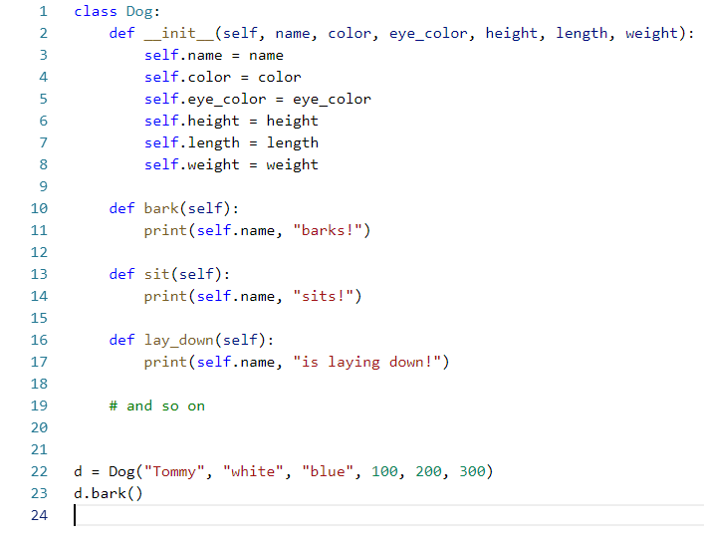
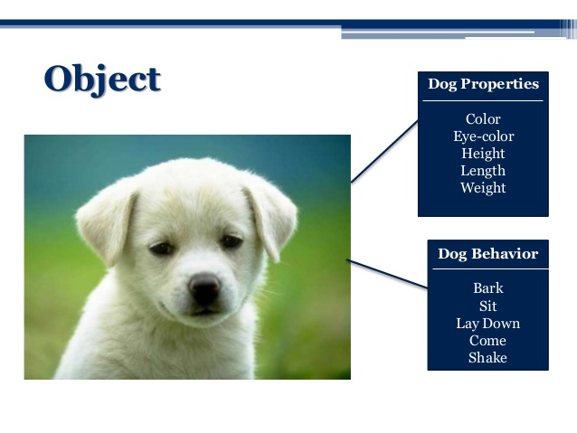
Recap - OOP
Constructor
Let’s create this dog class
Properties
Behaviors

Slide 3
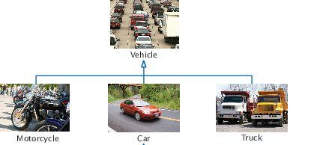
Recap - OOP
Inheritance
Parent-child relationship in classes

Slide 4
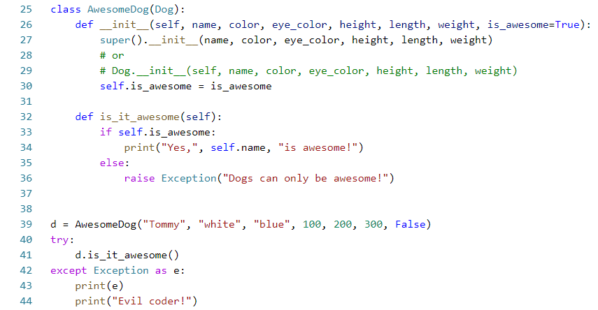
Recap - OOP
Call to parent constructor
Parent class
Method exclusive to child class

Slide 5
Composition
Class parameters don’t have to be fundamental types i.e. int, str etc.
Class parameters can be any object i.e
The same class
Object of another custom class
Be consistent with types
Easy test: has a …
Example: A Person can have a Dog

Slide 6
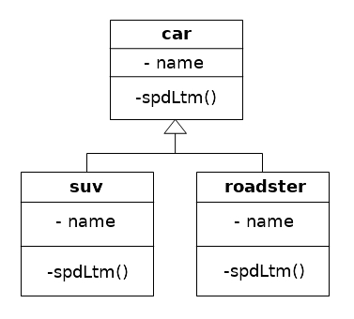
Polymorphism
Child class behaviors always override parent class behaviors

Slide 7
Operator Overloading
Built in operators can also be overridden
Every class has some predefined functions. For example,
__add__(self, other), __radd__(self, other) ⇒ +
__str__(self) ⇒ convert to string
__eq__(self, other) ⇒ ==
__ne__(self, other) ⇒ !=
It is better practice to check for type
Using type or isinstance

Slide 8
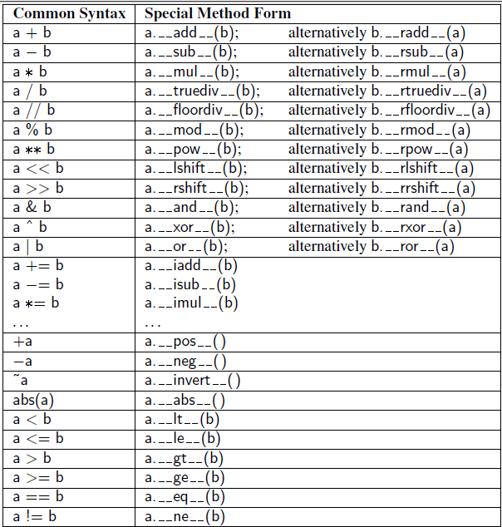
Operator Overloading

Slide 9
Encapsulation
Parameters can be public or private
Public parameters can be accessed as usual with the “.” operator
Private parameters
Cannot be accessed with “.” operator
Must start with “__” (two underscores)
The private members are not exactly private!!!

Slide 10
Lambdas
Using built in functions like max, sorted on fundamental data-types is easy
Using them on classes is difficult
Lambda is an inline function that can be stored in a variable
Lambdas are one liners
Lambdas are defined like this: lambda x, y: x+y
Example: sorted(some_list, key=lambda x: x.something)

Slide 11
Inline IF...ELSE
Single line IF statement
Used for assignment
Must have ELSE
Example:

Slide 12
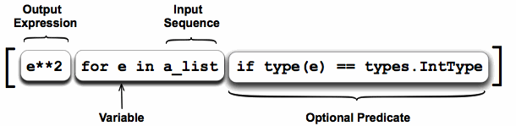
Comprehension
Inline operation for containers
Alternative for functions like filter, map etc.

